Slide 1
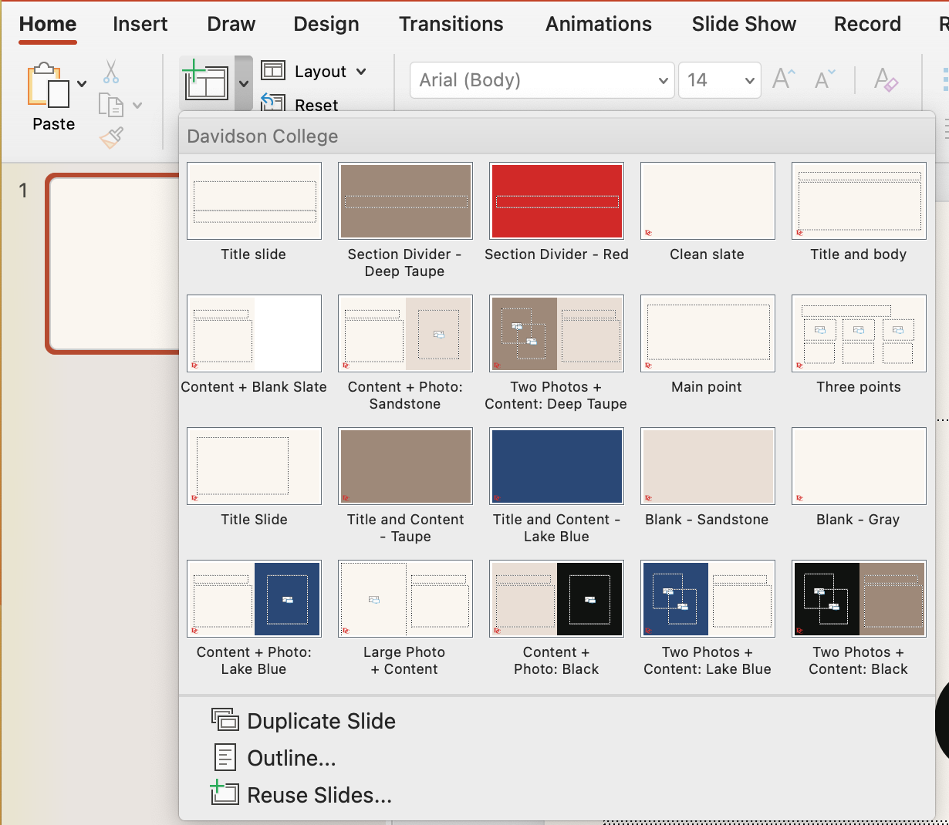
Click New Slide to access layout options.

